Slide 1


Stock Market Recommender for AAPL
Machine learning and pattern recognition

Slide 2


Table Of Contents
01
Introduction
02
Data preparation
Machine learning model application
03
Evaluation & Validation of models
04

Slide 3


INTRODUCTION
01

Slide 4
Team Members
Mayur kumar srivastava
Sachin Moze
Objective Two
20014162
Elaborate on what you want to discuss.
Objective Three
Muhammet Siar Temur
Objective Four
Hasara Jayasinghe
Elaborate on what you want to discuss.
Elaborate on what you want to discuss.
20030309

Slide 5

Business Understanding
The Apple Historical Dataset used for this assignment is taken from Kaggle. (https://www.kaggle.com/datasets/prasoonkottarathil/apple-lifetime-stocks-dataset)
The goal is to predict whether stock price is bearish, bullish or neutral.
This will help to predict the share market fluctuations accurately.

Slide 6

Data preparation Activities
RSI Calculations
MACD Calculation
Objective Two
Elaborate on what you want to discuss.
Objective Three
Objective Four
SMA calculations
EMA Calculations
Elaborate on what you want to discuss.
Elaborate on what you want to discuss.

Slide 7
Data preparation Activities Cntd…
Bollinger bands Calculations
True Range Calculation
Objective Two
Elaborate on what you want to discuss.
Objective Three
Objective Four
ATR calculations
CCI Calculations
Elaborate on what you want to discuss.
Elaborate on what you want to discuss.

Slide 8
Machine learning model application
03

Slide 9

SVC
Gradient boosting model
Using LDA for modeling and time calculation
SVC
Ensemble method
Random forest
Methodology

Slide 10

Evaluation & Validation of models
04

Slide 11

98%
Random forest accuracy score
96.9%
Accuracy score with LDA

Slide 12

Conclusion
Deployment
https://stocks-prediction-3i6n.onrender.com
Random Forest as deployed model

Slide 13
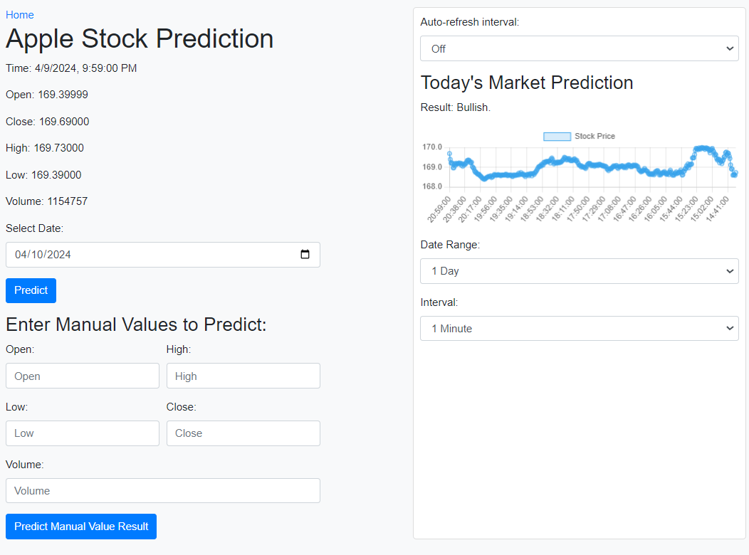
Conclusion
Deployment
https://stocks-prediction-3i6n.onrender.com
Random Forest as deployed model

Slide 14


Thank you!

